Slide 1

Her Ride
For woman by woman
Capstone project (Product Fundamentals)
By Ahana Podder

Slide 2

Her Ride: Empowering Women on the Move
In a bustling world, Her Ride emerges as a beacon of safety and empowerment for women. This innovative app is designed with a singular focus: to provide a secure and reliable transportation solution nationwide, driven by women, for women. Our mission is to foster a community where every journey is undertaken with confidence and peace of mind, enhancing mobility and independence for countless individuals across India.
At its core, Her Ride addresses the critical need for a trusted travel option. We aim to revolutionize urban commuting by prioritizing safety, comfort, and empowerment for both riders and drivers. Through intuitive design and robust features, we're not just offering rides; we're building a movement towards safer, more inclusive transportation. Join us as we redefine what it means to travel freely and confidently.

Slide 3

Problem Statement: Addressing Safety Concerns in Women's Transportation
In India, women frequently face significant safety concerns while using public and private transportation. These issues range from harassment and discomfort to more severe threats, leading to anxiety and limiting their mobility, particularly during late hours. The lack of secure options restricts opportunities for education, employment, and social engagement, impacting women's overall empowerment and economic participation. Existing solutions often fall short in providing a truly safe and trusted environment.

Slide 4

Unveiling the Needs:Customer Interviews
To truly understand the challenges and aspirations of our target users, we conducted extensive customer interviews with women across various demographics in India. These conversations were pivotal in shaping Her Ride's value proposition, helping us identify critical pain points and unmet needs in their daily transportation experiences. Our structured approach focused on key areas to gather actionable insights.
Safety Perceptions & Incidents
What specific situations make you feel unsafe during travel? Have you experienced any negative incidents while using public or private transport?
Current Commuting Habits
How do you currently travel? What are the biggest frustrations or inconveniences you face with these options, especially regarding reliability and comfort?
Desired Features & Expectations
What features or services would significantly improve your travel experience? What would a 'safe and empowering' transportation service look like to you?
Trust & Willingness to Pay
What factors influence your trust in a transportation service? How much would you be willing to pay for a premium service that guarantees safety and reliability?

Slide 5

Unveiling the Needs: Insights from Customer Interviews
To truly understand the challenges, we conducted extensive interviews with women across various demographics. The feedback was clear and consistent:
Safety is paramount: Women prioritise feeling secure above all else.
Trust in drivers: A significant concern revolved around the trustworthiness of male drivers.
Cleanliness and comfort: Many desired clean, well-maintained vehicles.
Emergency support: The need for quick, accessible emergency features was frequently highlighted.
Empowerment: The idea of supporting other women drivers resonated strongly.

Slide 6

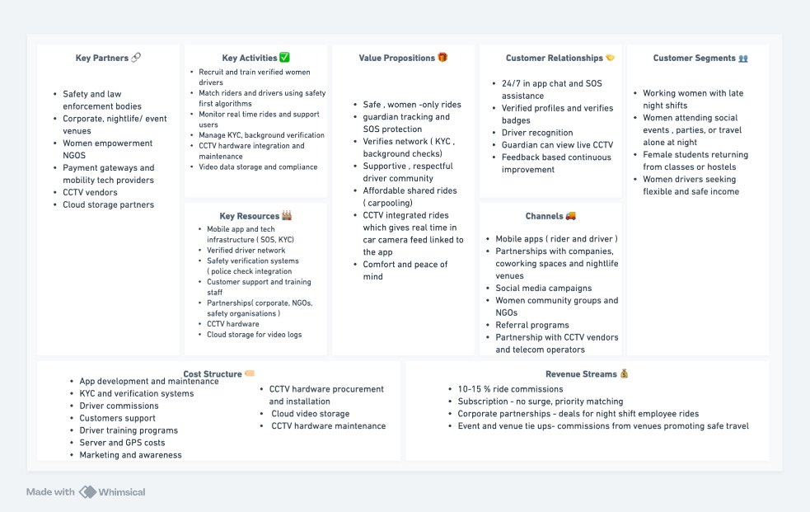
Strategic Blueprint: Her Ride Business Model Canvas

Slide 7


Understanding Our Users: Rider and Driver Personas
Rider Persona: Aisha Sharma
Driver Persona: Priya Devi
Aisha, a vibrant 28-year-old marketing professional in Mumbai, often dedicates long hours to her ambitious career. However, her evenings are frequently shadowed by the persistent worry of finding safe and reliable transport home. She prioritizes her personal safety above all else, craving a service that not only offers convenience and dependability but also grants her profound peace of mind, allowing her to fully immerse herself in her professional aspirations without a moment's fear.
Priya, a resilient 45-year-old mother of two from Delhi, is an experienced driver driven by the desire to provide for her family. She actively seeks a flexible income source that offers not just fair pay, but also genuine respect and a safe, empowering working environment. Her dedication and reliability are unwavering, as she eagerly contributes to her family's well-being, all while feeling secure and supported on every journey. She yearns for a community that values her skill and dedication.
Goals
Goals
Achieve career ambitions and professional growth.
Ensure financial stability and provide for her family's needs.
Maintain independence and control over her schedule.
Gain respect and recognition for her professional driving skills.
Enjoy peace of mind knowing her commute is safe and reliable.
Work in a safe, supportive, and empowering environment.
Pain Points
Pain Points
Constant worry about personal safety during commutes, especially at night.
Income instability and unpredictable earnings from current opportunities.
Frustration with unreliable and unpredictable transportation services.
Exposure to unsafe working conditions and lack of security.
Wasted time waiting for rides, impacting work-life balance.
Lack of respect and fair treatment in male-dominated transportation sectors.

Slide 8
Crafting the Experience: Value Proposition Canvas for Riders and Drivers
Rider Value Proposition: Safety & Convenience
Driver Value Proposition: Empowerment & Fair Earning
Customer Jobs: Commuting safely, reliable transport, accessing opportunities.
Customer Jobs: Earning income, flexible work, safe driving environment.
Pains: Unsafe experiences, lack of trust, limited late-night options, anxiety.
Pains: Unsafe passengers, unfair commissions, lack of support, harassment.
Gains: Peace of mind, empowerment, convenient booking, secure journey.
Gains: Respectful work, good income, community support, personal safety.
Pain Relievers: Verified female drivers, in-app SOS button, real-time tracking, background checks.
Pain Relievers: Women-only passengers, fair commission rates, 24/7 support, driver community.
Gain Creators: Clean vehicles, supportive community, seamless booking, flexible scheduling.
Gain Creators: Training programs, incentives, flexible hours, vehicle maintenance assistance.

Slide 9
Diving Deep into Emotions: Empathy Map for Riders and Drivers
Rider Empathy Map
Driver Empathy Map
Says: "All I ask for is a ride where I don't have to look over my shoulder." "I yearn for a world where I can travel at any hour without a knot in my stomach."
Says: "This isn't just a job; it's how I put food on the table for my children." "I deserve to earn my living with dignity and respect, like anyone else."
Thinks: Is this driver truly vetted? Am I making myself vulnerable just by stepping into this car? Will my family wonder if I'm okay if I don't check in frequently?
Thinks: Will today be enough to cover rent and school fees? Is this passenger going to be abusive or try to shortchange me? I wish there was a clear path to genuine financial stability, not just scraping by.
Feels: Profoundly anxious before and during rides, a palpable sense of vulnerability, an immense wave of relief upon safe arrival, and a quiet sense of empowerment when she feels a modicum of control.
Feels: Fiercely determined to succeed, often battling a sense of being undervalued or exploited, yet deeply proud of her hard-won independence and the vital role she plays for her family.
Does: Insistently shares her live location with trusted contacts, often engages in phone calls with family or friends throughout the journey, and actively plans her schedule to avoid late-night travel or relies solely on trusted, personal arrangements.
Does: Drives with meticulous caution and adherence to safety protocols, invests time and effort into maintaining her vehicle impeccably, and actively seeks out platforms or opportunities that offer more flexible hours and better earning conditions.

Slide 10

Building the Foundation: Minimum Viable Product (MVP)
User-Friendly Mobile App
Verified Female Drivers
Intuitive interface for booking, tracking, and payment.
Stringent background checks and training for all drivers.
In-App SOS Feature
Real-Time Tracking & Sharing
One-tap emergency assistance and direct line to support.
Passengers can share live trip details with trusted contacts.
Our MVP focuses on core safety and booking functionalities, ensuring a secure and reliable experience from day one. This initial release will gather crucial feedback for future enhancements.

Slide 11
Charting the Future: MVP Roadmap
Phase 1: Launch & Stabilisation
Phase 3: Geographic Expansion
Pilot in one major city, gather user feedback, refine core features.
Expand to additional cities, build stronger community partnerships.
App deployment
New city launches
Driver onboarding
Partnerships
Marketing campaign
Local marketing
1
2
3
4
Phase 2: Feature Expansion
Phase 4: Ecosystem Development
Introduce advanced safety tools, driver incentives, and loyalty programs.
Explore additional services like women-centric delivery or logistics.
In-app chat
Women-led deliveries
Ride scheduling
Community events
Referral programme
Advanced analytics
This roadmap outlines our strategic growth, starting with a strong foundation and progressively building towards a comprehensive ecosystem for women's mobility and empowerment.

Slide 12
Standing Out: Comparing Her Ride with Other Solutions
Her Ride
Uber
Ola
Driver Gender
Exclusively Female
Mixed
Mixed
Primary Focus
Women's Safety, Empowerment & Community Building
Convenience, Market Share & General Transportation
Affordability, Localized Convenience & Broad Reach
Safety Features
Advanced (SOS, Vetted Female Drivers, real-time tracking, in-app support)
Standard (GPS tracking, emergency button, share trip, basic driver screening)
Standard (GPS tracking, SOS button, driver verification, some in-car CCTV)
Community Aspect
Strong (Support networks for female drivers, training, community events)
Minimal (Driver ratings, some partnerships, general support)
Minimal (Driver ratings, localized driver support, limited community focus)
Target Audience
Women Riders & Drivers, families prioritizing safety & empowerment
General Public, commuters, business
travelers
General Public, price-sensitive riders, diverse segments
Driver Training & Support
Comprehensive (Self-defense, first aid, customer service, financial literacy, community support groups)
Basic (App usage, regulatory compliance, basic safety guidelines)
Basic (App usage, regulatory compliance, basic safety guidelines)
Commission Structure
Fair & Transparent (Lower commission, direct support for drivers, potential profit-sharing)
Standard (Higher commission rates, variable pricing)
Standard (Higher commission rates, competitive pricing)
Women's Empowerment Focus
Central to Mission (Economic independence for women, safe mobility for women, mentorship programs)
Limited/General (Broader diversity initiatives, but not core mission)
Limited/General (Broader diversity initiatives, but not core mission)
Her Ride fundamentally redefines urban mobility by placing women's safety and empowerment at its core. Unlike mainstream platforms like Uber and Ola, which offer general transportation, Her Ride provides a purpose-driven, secure ecosystem where every ride contributes to economic independence for women drivers and unparalleled peace of mind for women riders. This makes Her Ride not just a service, but a movement setting a new, higher standard for inclusive and safe transportation.

Slide 13
Thank You

